Slide 1
16-bit Carry-Lookahead Adder
EEE 468 –VLSI Circuit and Design Laboratory
Level-4 Term-2
Final Project Presentation
Submitted by – G2-
1906081, 1906174, 1906192, 1906193
Group 03
07 December 2024
Supervisors:
Nafis Sadik
Lecturer,
Dept. of Electrical and Electronic Engineering
BUET, Dhaka
Rafid Hassan Palash
Lecturer(PT),
Dept. of Electrical and Electronic Engineering
BUET, Dhaka

Slide 2
Outline
Summary
PnR with DRC
Introduction
Directed Testbench
Layered Testbench
Design RTL
Synthesis
Optimization
Acknowledgement and References
Presented by: 1906081

Slide 3
Outline
Summary
PnR with DRC
Introduction
Directed Testbench
Layered Testbench
Design RTL
Synthesis
Optimization
Acknowledgement and References
Presented by: 1906081

Slide 4
16-bit Carry-Lookahead Adder
Designed an optimized 16 Bit Carry Lookahead Adder
RTL Design
Directed
Testbench
Layered
Testbench
Synthesis
PnR with
DRC
Presented by: 1906081

Slide 5
Outline
Summary
PnR with DRC
Introduction
Directed Testbench
Layered Testbench
Design RTL
Synthesis
Optimization
Acknowledgement and References
Presented by: 1906081

Slide 6
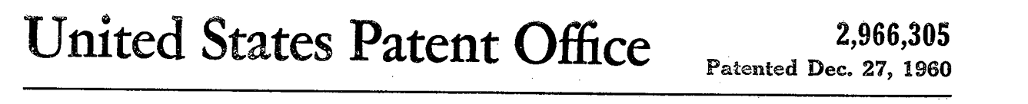
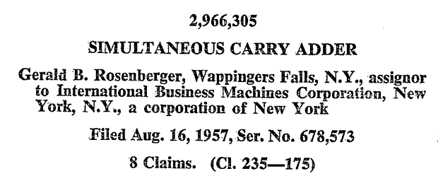
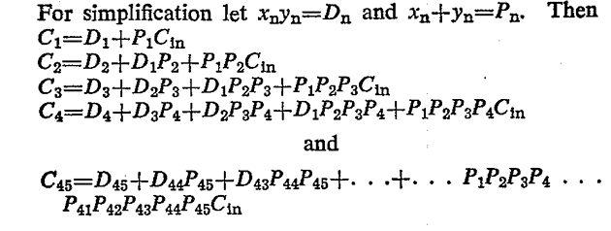
Introduction
[1] G. B. Rosenberger, “Simultaneous Carry Adder,” Dec. 27, 1960 Accessed: Dec. 06, 2024. [Online]. Available: https://patents.google.com/patent/US2966305
Presented by: 1906081

Slide 7
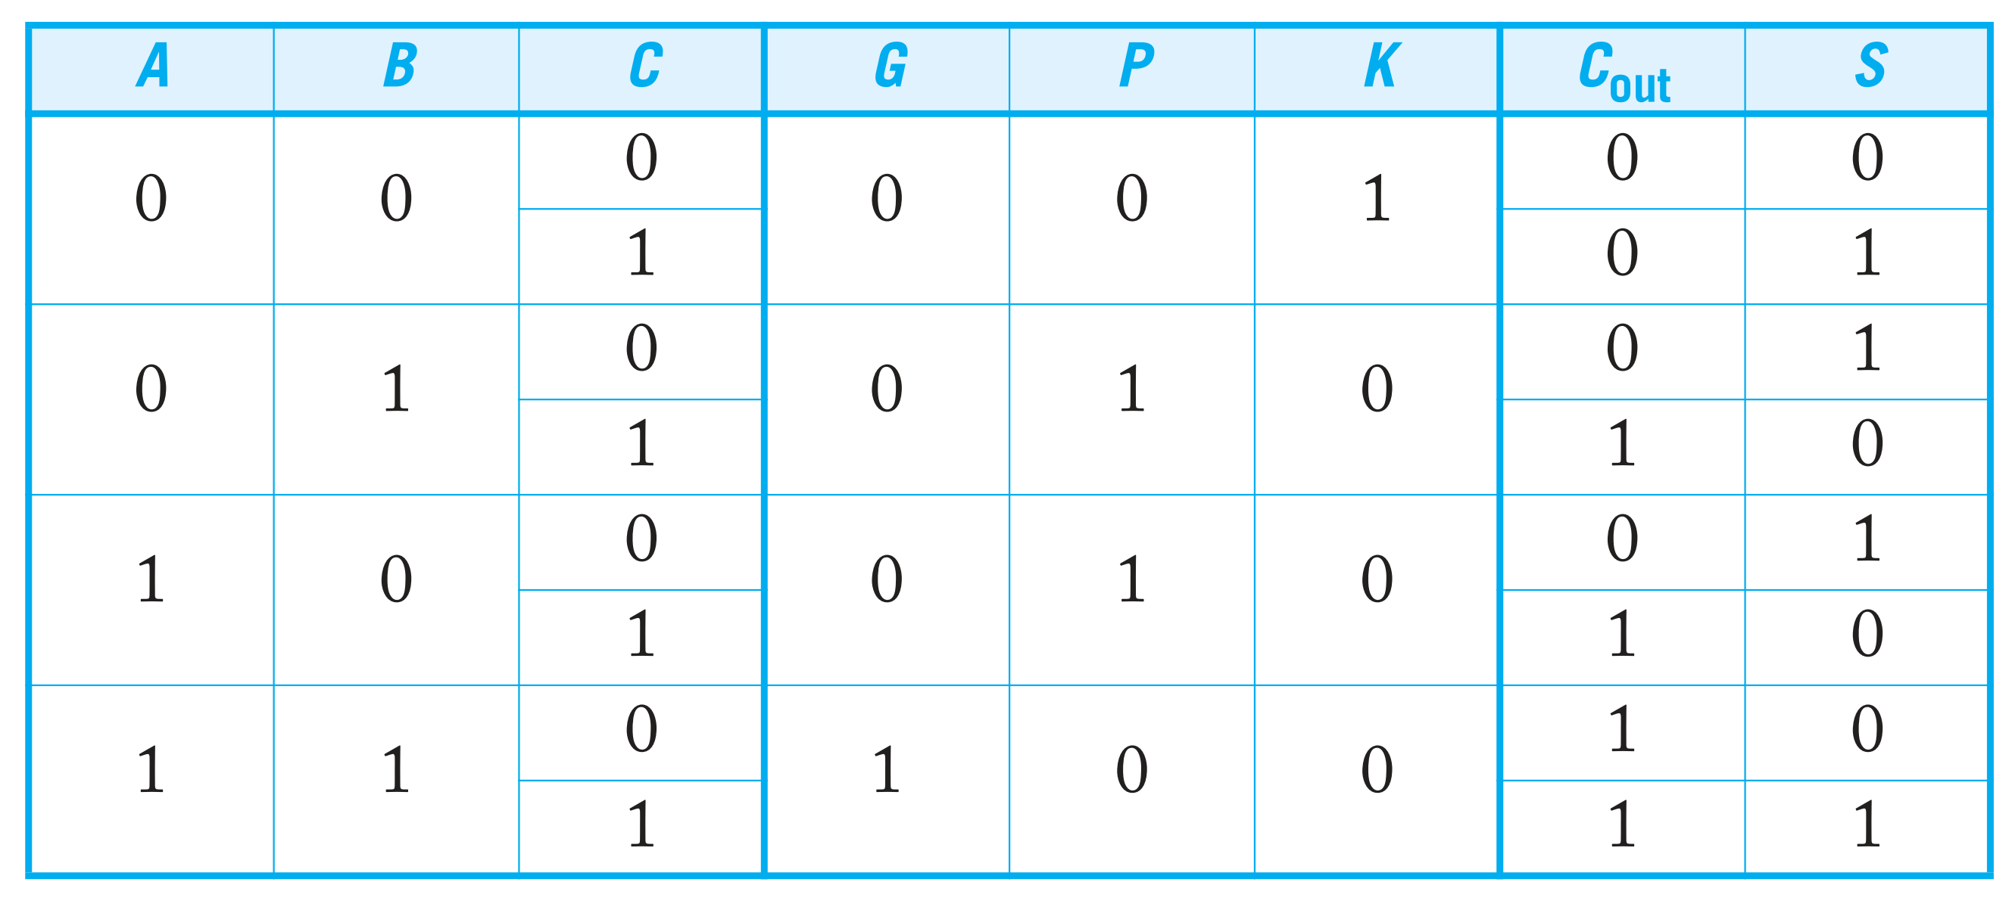
Introduction
[2] N. H. E. Weste and David Money Harris, CMOS VLSI design : a circuits and systems perspective. Noida: Pearson, 2015.
Presented by: 1906081

Slide 8
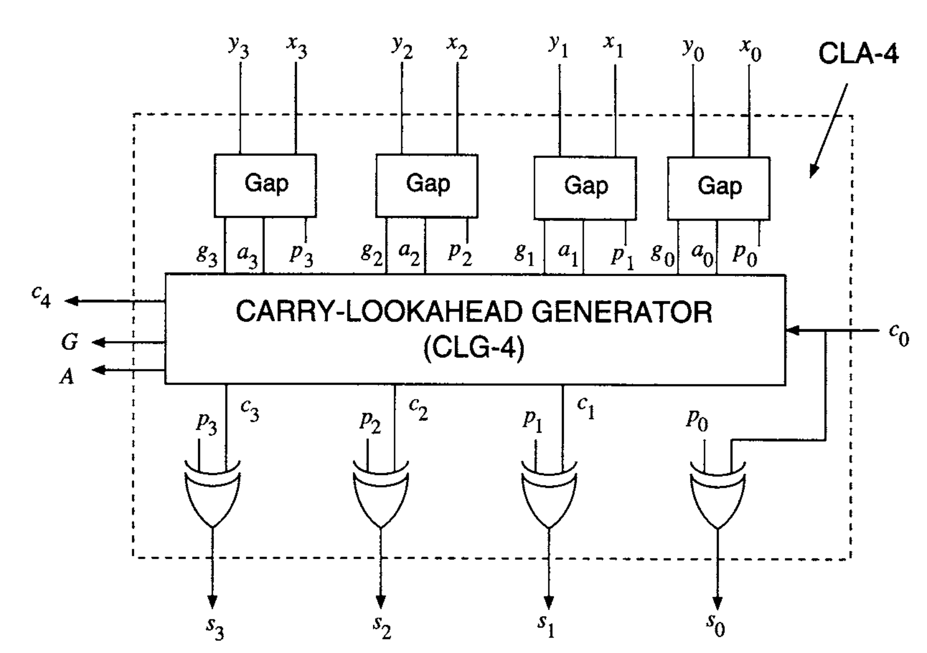
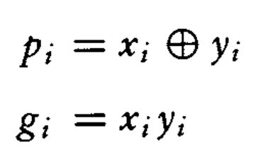
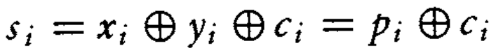
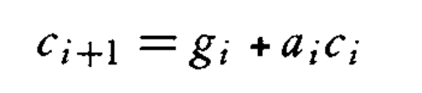
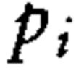
Introduction
[3] ErcegovacM. D. and LangT., Digital arithmetic. San Francisco, Ca: Morgan Kaufmann Publishers, 2004.
Presented by: 1906081

Slide 9
Outline
Summary
PnR with DRC
Introduction
Directed Testbench
Layered Testbench
Design RTL
Synthesis
Optimization
Acknowledgement and References
Presented by: 1906081

Slide 10
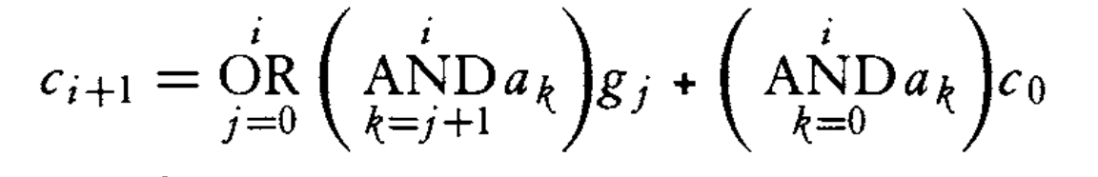
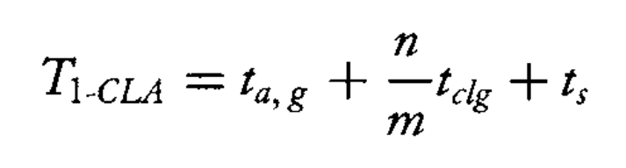
RTL Design
Optimization-1:
Presented by: 1906081
Notes:
we can see the carry equation becomes very complex as the number of bits increases. For bit position 15, we would need:
One 16-input OR gate
15 AND gates with input sizes ranging from 2 to 16 This makes the implementation impractical due to large fan-in requirements.
9+
Let me help you analyze the delays for 16-bit addition comparing a one-level CLA with directly implementing a 16-bit CLA.
For your 4-bit x 4 CLA implementation:
Total bits (n) = 16
Group size (m) = 4
Number of groups = n/m = 4
For a direct 16-bit CLA implementation: From equation 2.41, we can see the carry equation becomes very complex as the number of bits increases. For bit position 15, we would need:
One 16-input OR gate
15 AND gates with input sizes ranging from 2 to 16 This makes the implementation impractical due to large fan-in requirements.
T1-CLA = ta,g + (n/m)tclg + ts = ta,g + (16/4)tclg + ts = ta,g + 4tclg + ts
Where:
ta,g = Time to compute generate and propagate signals
tclg = Time for carry lookahead generator (much smaller for 4-bit groups)
ts = Time to compute final sum

Slide 11
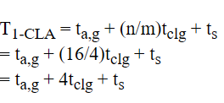
RTL Design
Optimization-1:
Presented by: 1906081
Notes:
For a direct 16-bit CLA implementation: From equation 2.41, we can see the carry equation becomes very complex as the number of bits increases. For bit position 15, we would need:
One 16-input OR gate
15 AND gates with input sizes ranging from 2 to 16 This makes the implementation impractical due to large fan-in requirements.
ta,g = Time to compute generate and propagate signals
tclg = Time for carry lookahead generator (much smaller for 4-bit groups)
ts = Time to compute final sum
The advantages of this approach:
Each CLA block only needs to handle 4 bits, so:
Maximum OR gate input = 5 (vs 16)
Maximum AND gate input = 5 (vs 16)
Reduced complexity and fan-in
Faster tclg due to simpler logic

Slide 12
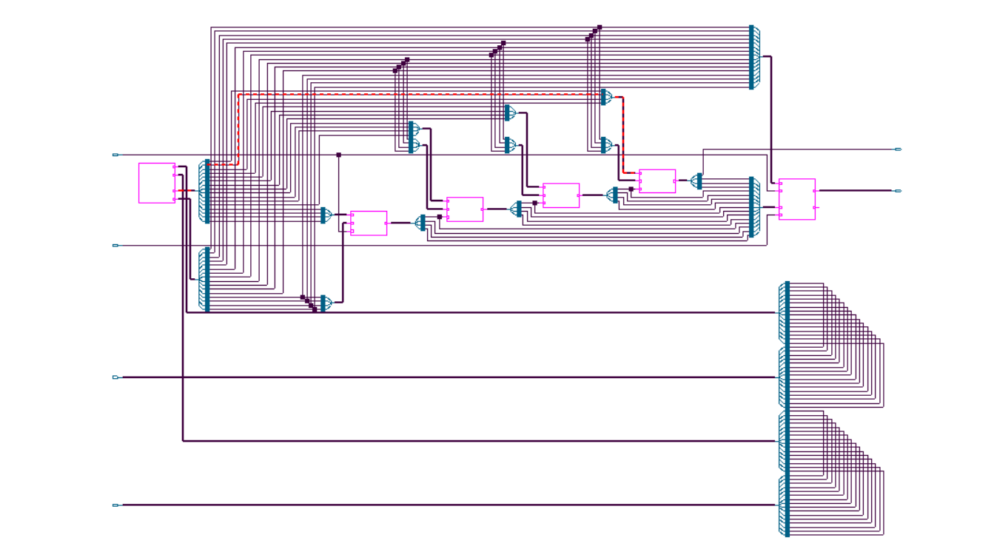
RTL Design
Presented by: 1906081
Notes:
For a direct 16-bit CLA implementation: From equation 2.41, we can see the carry equation becomes very complex as the number of bits increases. For bit position 15, we would need:
One 16-input OR gate
15 AND gates with input sizes ranging from 2 to 16 This makes the implementation impractical due to large fan-in requirements.
ta,g = Time to compute generate and propagate signals
tclg = Time for carry lookahead generator (much smaller for 4-bit groups)
ts = Time to compute final sum
The advantages of this approach:
Each CLA block only needs to handle 4 bits, so:
Maximum OR gate input = 5 (vs 16)
Maximum AND gate input = 5 (vs 16)
Reduced complexity and fan-in
Faster tclg due to simpler logic

Slide 13
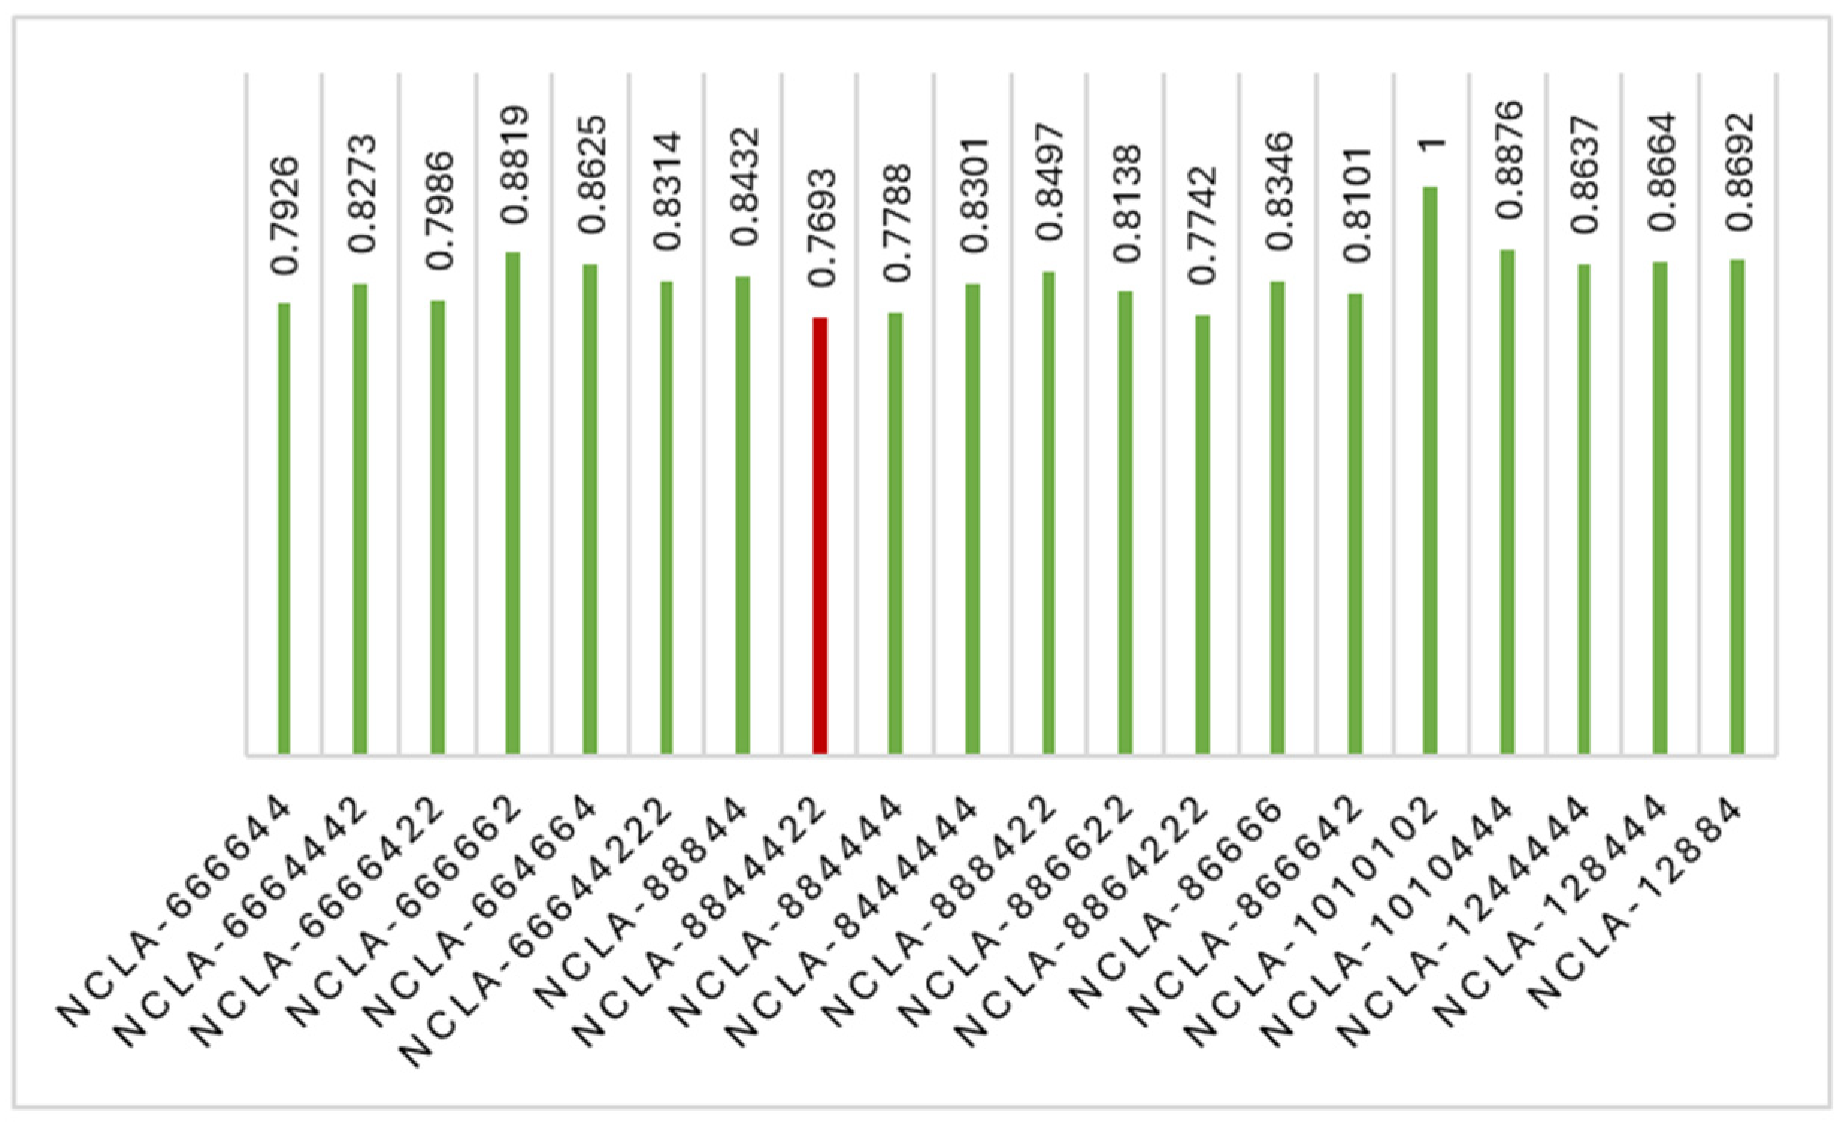
RTL Design (Insert Genus Pic)
Attempted Optimization-1:
[3] P. Balasubramanian and D. L. Maskell, “A New Carry Look-Ahead Adder Architecture Optimized for Speed and Energy,” Electronics, vol. 13, no. 18, pp. 3668–3668, Sep. 2024, doi: https://doi.org/10.3390/electronics13183668.
Presented by: 1906081
Notes:
For a direct 16-bit CLA implementation: From equation 2.41, we can see the carry equation becomes very complex as the number of bits increases. For bit position 15, we would need:
One 16-input OR gate
15 AND gates with input sizes ranging from 2 to 16 This makes the implementation impractical due to large fan-in requirements.
ta,g = Time to compute generate and propagate signals
tclg = Time for carry lookahead generator (much smaller for 4-bit groups)
ts = Time to compute final sum
The advantages of this approach:
Each CLA block only needs to handle 4 bits, so:
Maximum OR gate input = 5 (vs 16)
Maximum AND gate input = 5 (vs 16)
Reduced complexity and fan-in
Faster tclg due to simpler logic

Slide 14
Outline
Summary
PnR with DRC
Introduction
Directed Testbench
Layered Testbench
Design RTL
Synthesis
Optimization
Acknowledgement and References
Presented by: 1906081

Slide 15
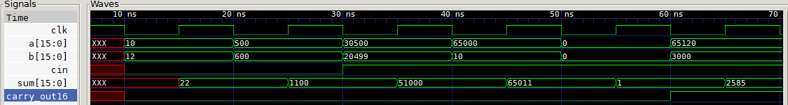
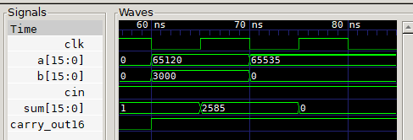
Directed Testbench
Presented by: 1906081

Slide 16
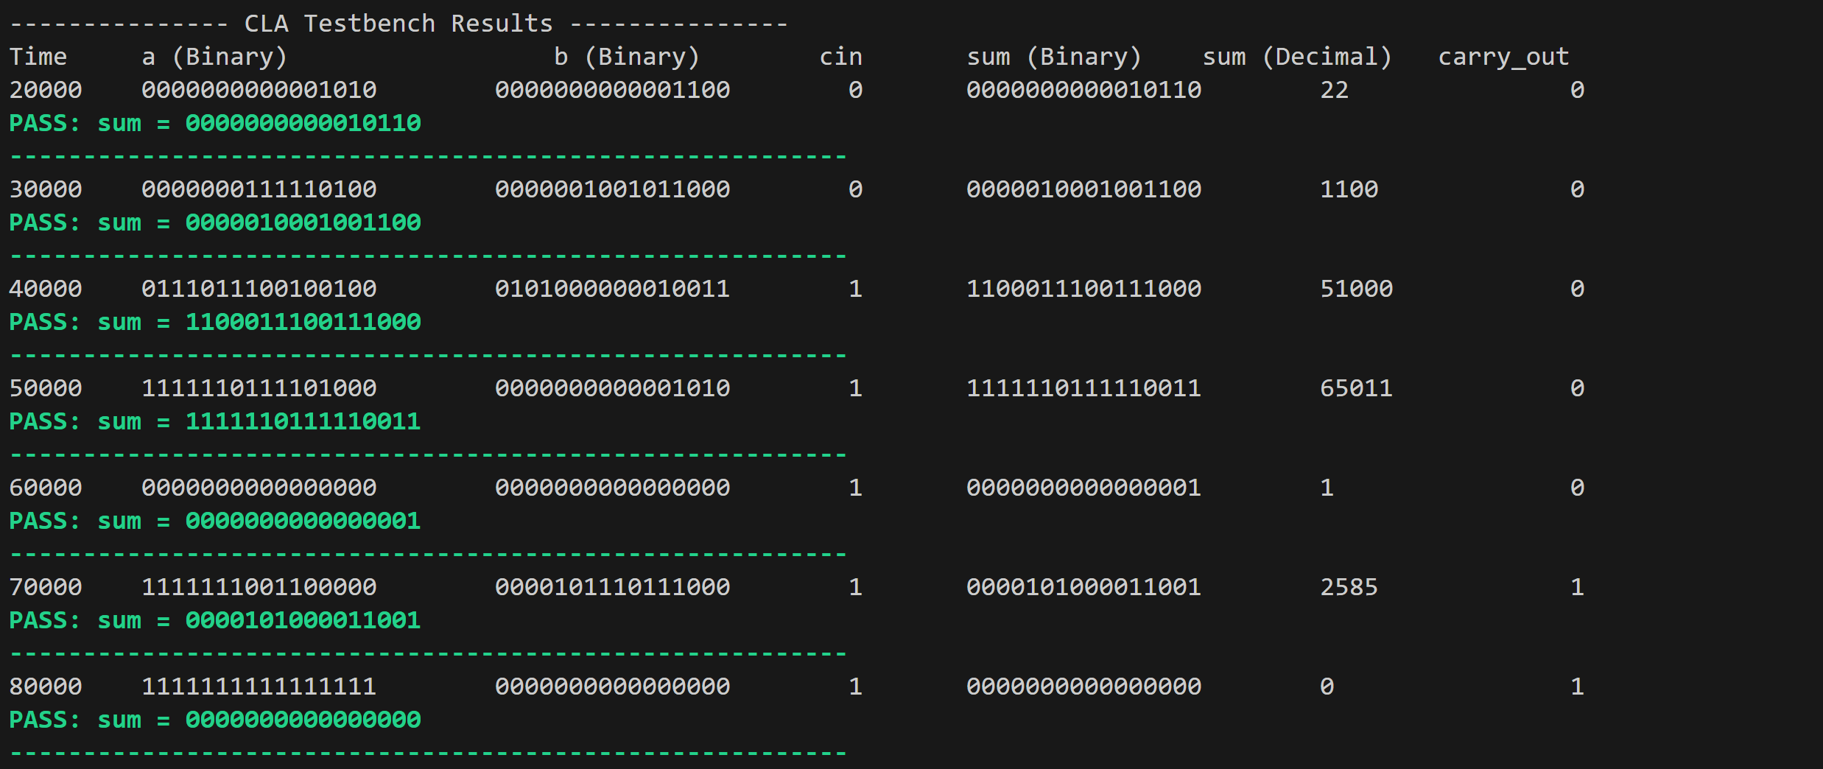
Self Checking Testbench
Presented by: 1906081

Slide 17
Outline
Summary
PnR with DRC
Introduction
Directed Testbench
Layered Testbench
Design RTL
Synthesis
Optimization
Acknowledgement and References
Presented by: 1906081

Slide 18
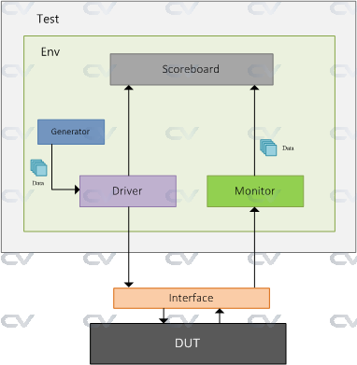
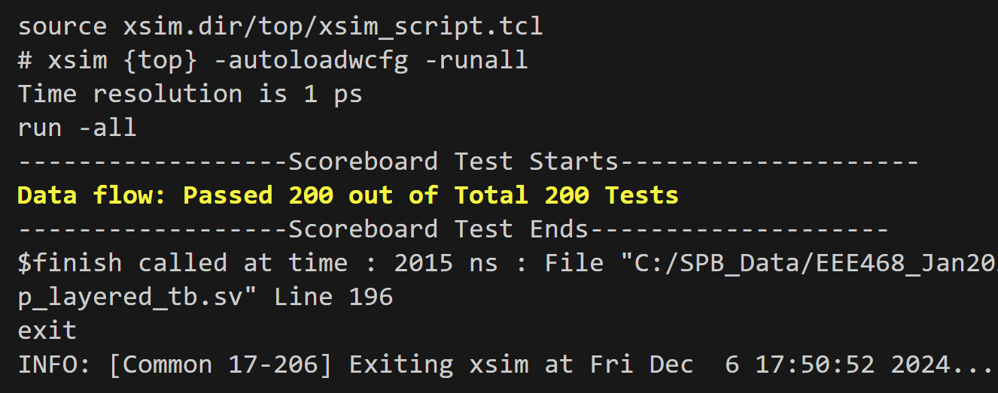
Layered testbench
[4] “SystemVerilog TestBench,” ChipVerify. https://www.chipverify.com/systemverilog/systemverilog-simple-testbench
Presented by: 1906081

Slide 19
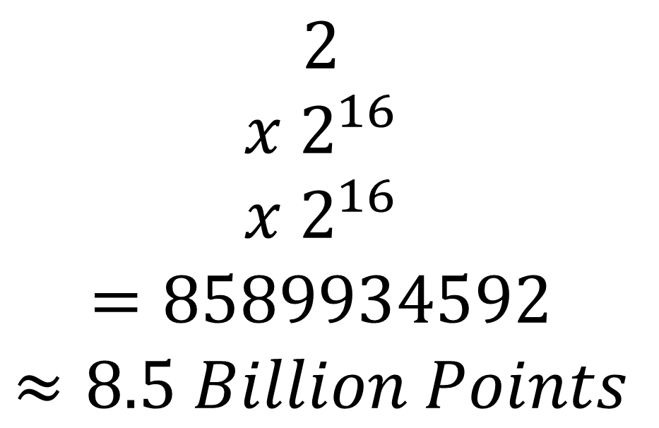
Layered testbench: 3D Space
$$2$$
$$x 2^{16}$$
$$x 2^{16}$$
$$=8589934592$$
$$≈8.5 Billion Points$$
input c
input [15:0] a
input [15:0] b
Presented by: 1906081

Slide 20
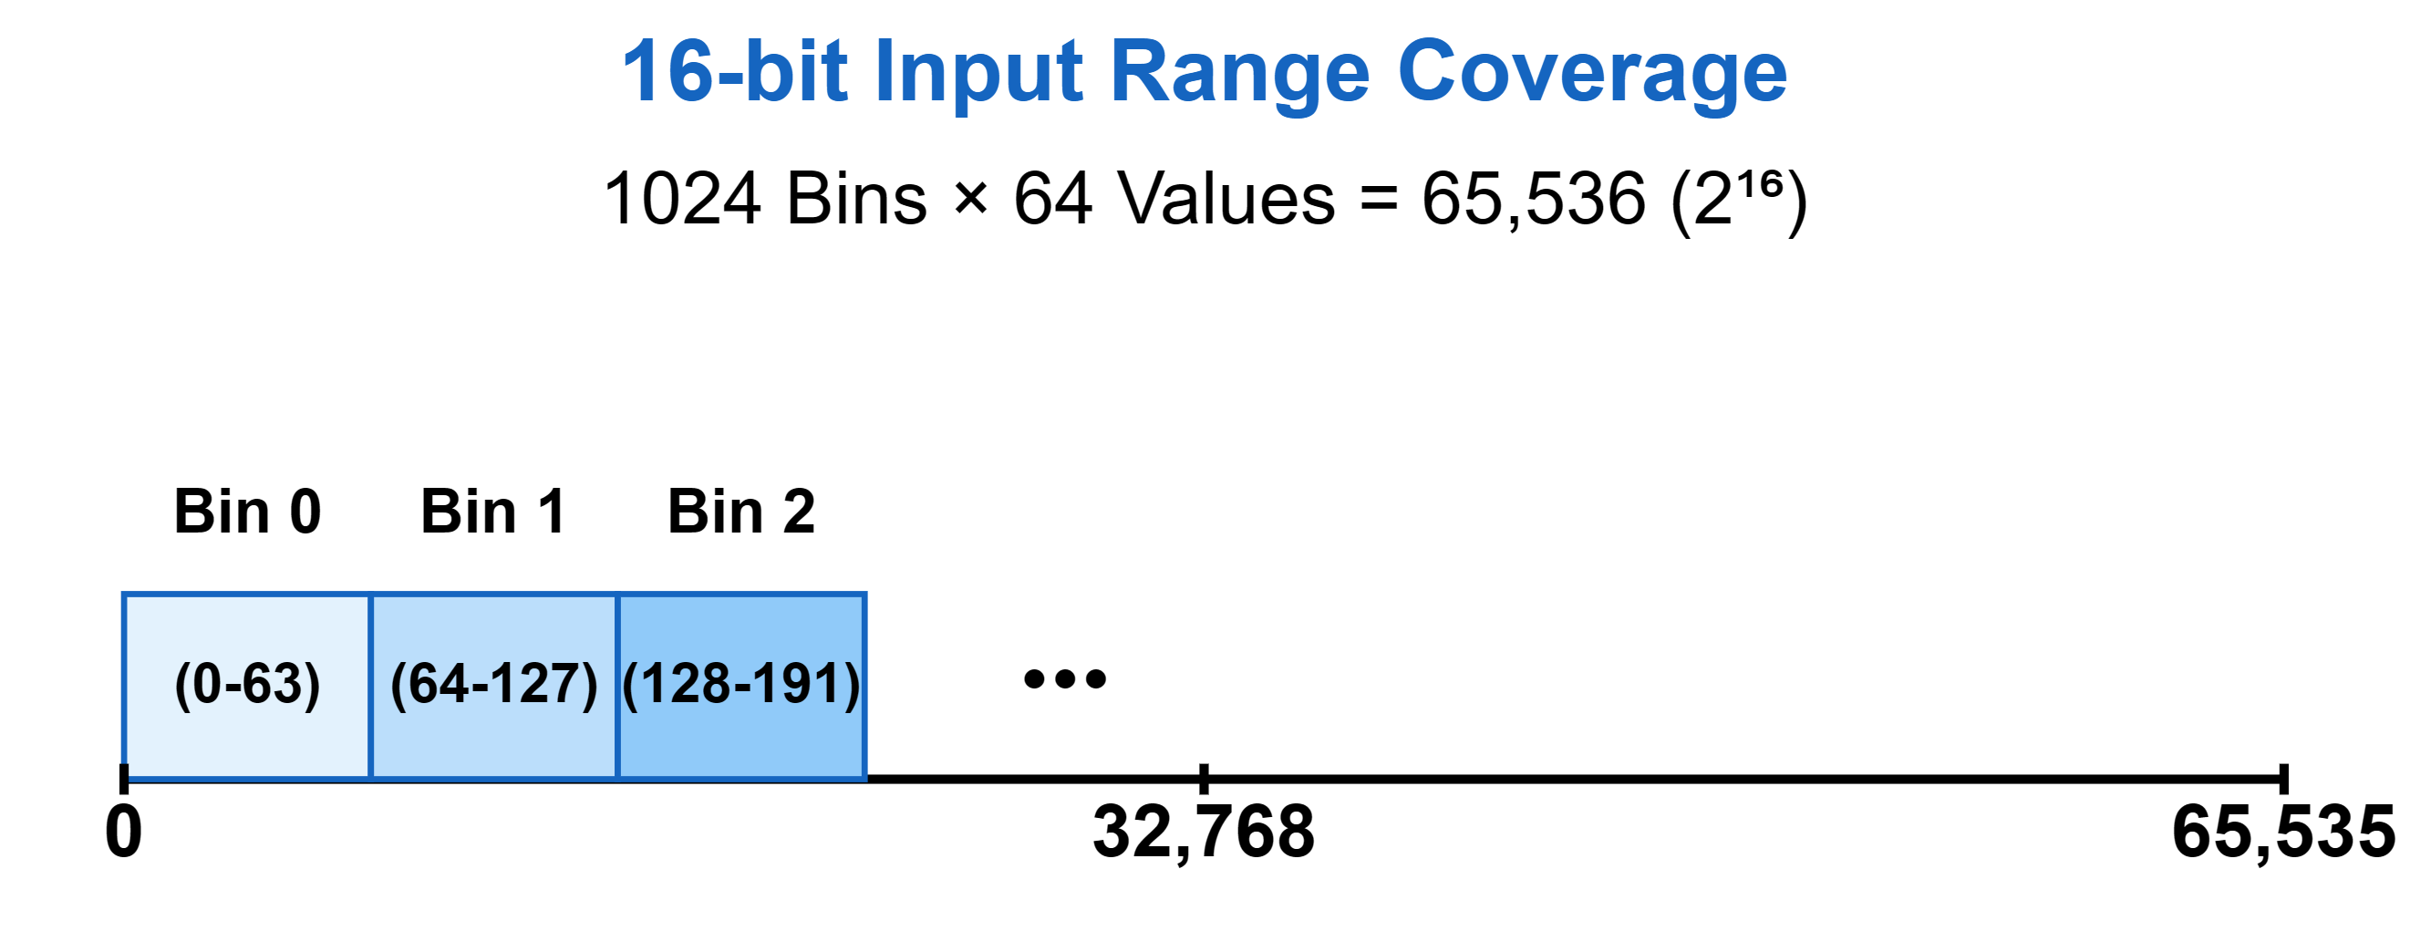
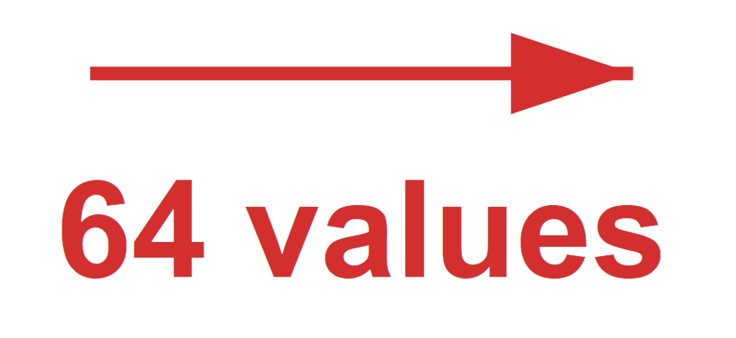
Layered testbench: 3D Space
// Global parameters for bin configuration
parameter int BIN_COUNT = 1024;
parameter int BIN_BITS = $clog2(BIN_COUNT);
// Basic parameters for coverage tracking
localparam int TOTAL_3D_POINTS = 2 * BIN_COUNT * BIN_COUNT;
Presented by: 1906081

Slide 21
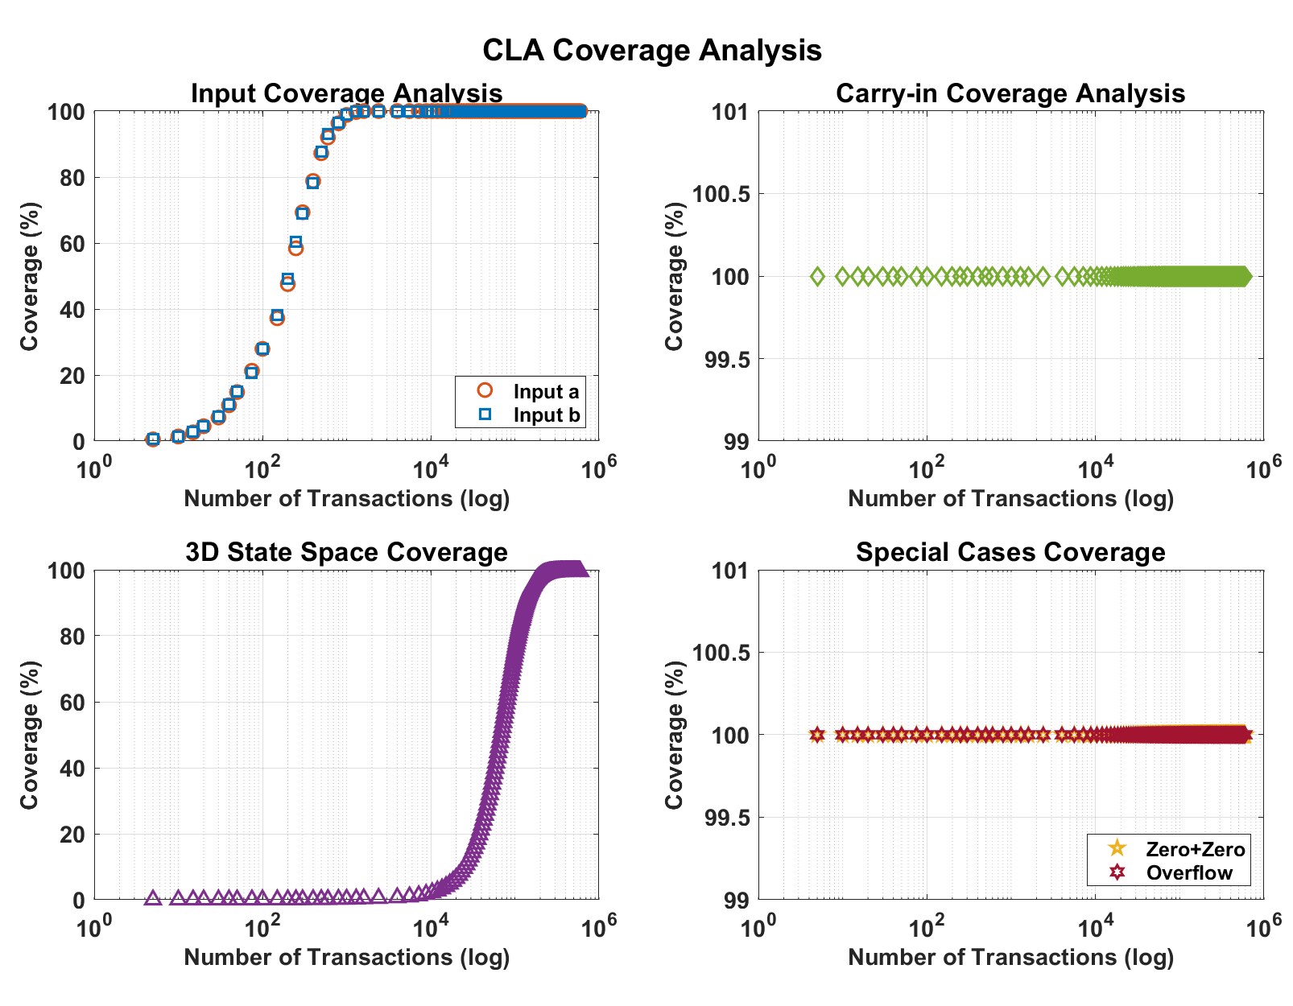
Layered
Testbench: Coverage with Transactions
Rand Function
Up to 240k Transactions
Non-linear Manual Setup
1024 Bins for 16 Bit Input Range
Data Collection in File
All Compare Function
Presented by: 1906081

Slide 22
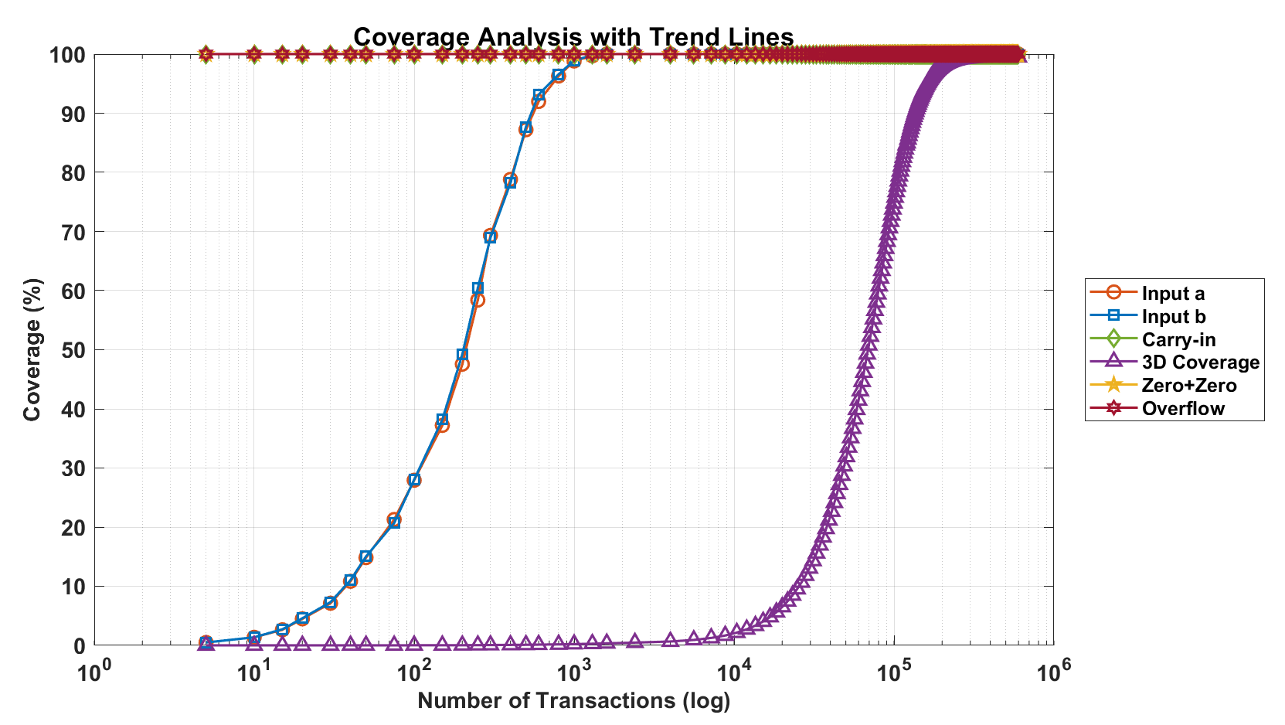
Layered Testbench: Coverage with Transactions
Presented by: 1906081

Slide 23
Outline
Summary
PnR with DRC
Introduction
Directed Testbench
Layered Testbench
Design RTL
Synthesis
Optimization
Acknowledgement and References
Presented by: 1906174

Slide 24
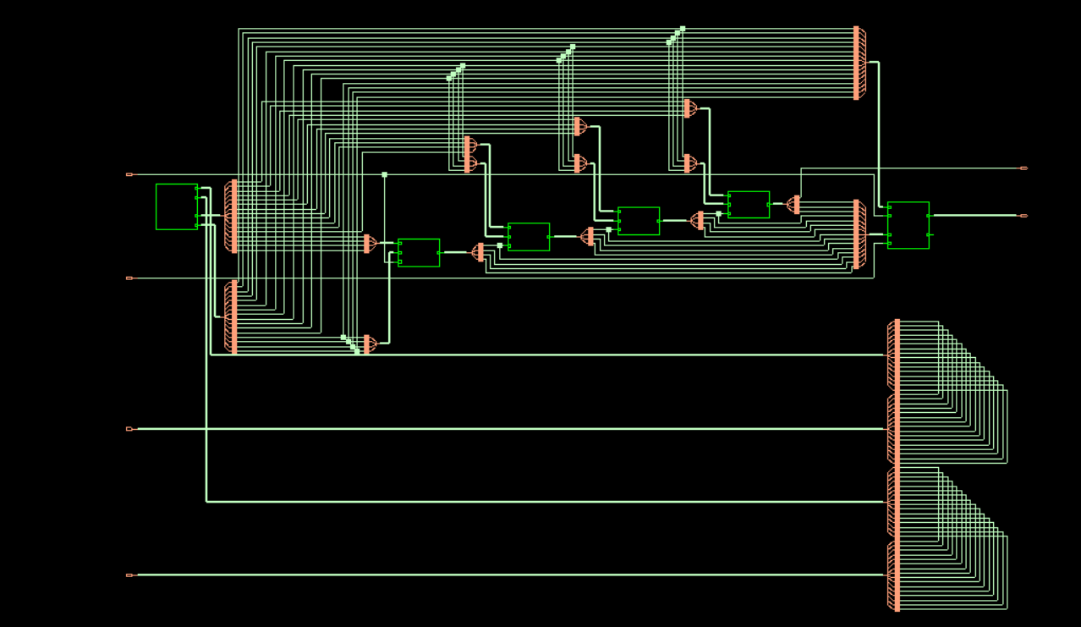
Fig: Schematic of Carry Lookahead Adder
Presented by: 1906174

Slide 25
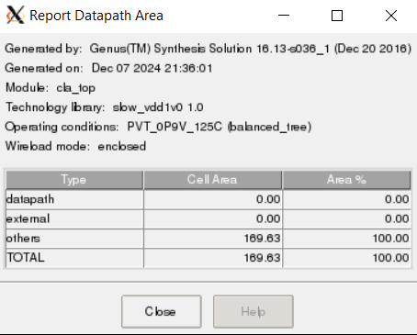
Fig: Report Of Datapath Area
Presented by: 1906174

Slide 26
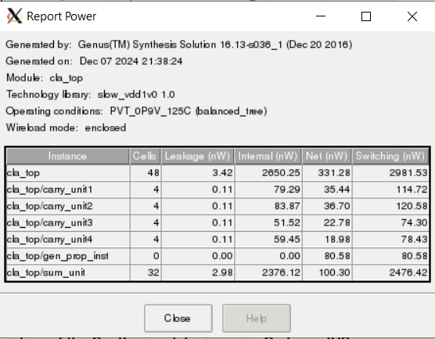
Fig: Power Report
Presented by: 1906174

Slide 27
SDC Code:
# setting up time units
set_units -time 1ns -capacitance pF
# setting the clock period 10ns, as period = 1/freq, here, freq = 100MHz
set clock_period 10;
set top_module "cla_top"
set clock_port {clk};
# setting the input ports in a list to a variable
set input_ports {a, b, cin} ;
# setting the output ports in a list to a variable
set output_ports {sum, carry_out16} ;
# define the clocks
create_clock -period ${clock_period} -waveform {0 6} -name func_clk
[get_ports ${clock_port}]
# setting up constraints for the reset signal
# Define input delays
set_input_delay 0.4 -clock [get_clocks {func_clk}] ${input_ports}
# Define output delays
set_output_delay 0.6 -clock [get_clocks {func_clk}] ${output_ports}
No Reset Port As Per Project Requirement
No Multicycle Setup Time/Hold Time
Presented by: 1906174

Slide 28
Outline
Summary
PnR with DRC
Introduction
Directed Testbench
Layered Testbench
Design RTL
Synthesis
Optimization
Acknowledgement and References
Presented by: 1906193

Slide 29
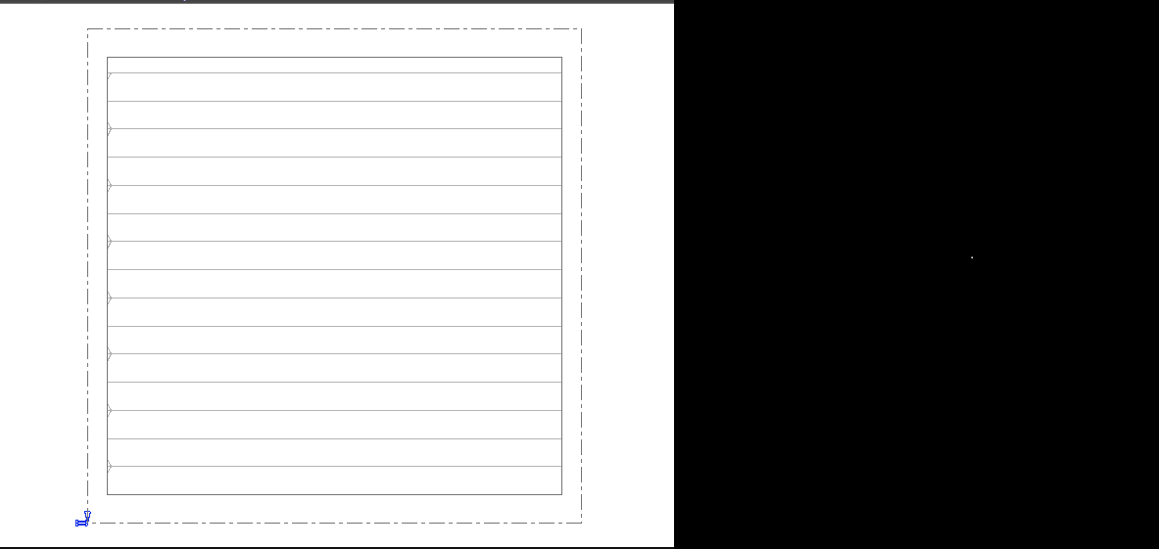
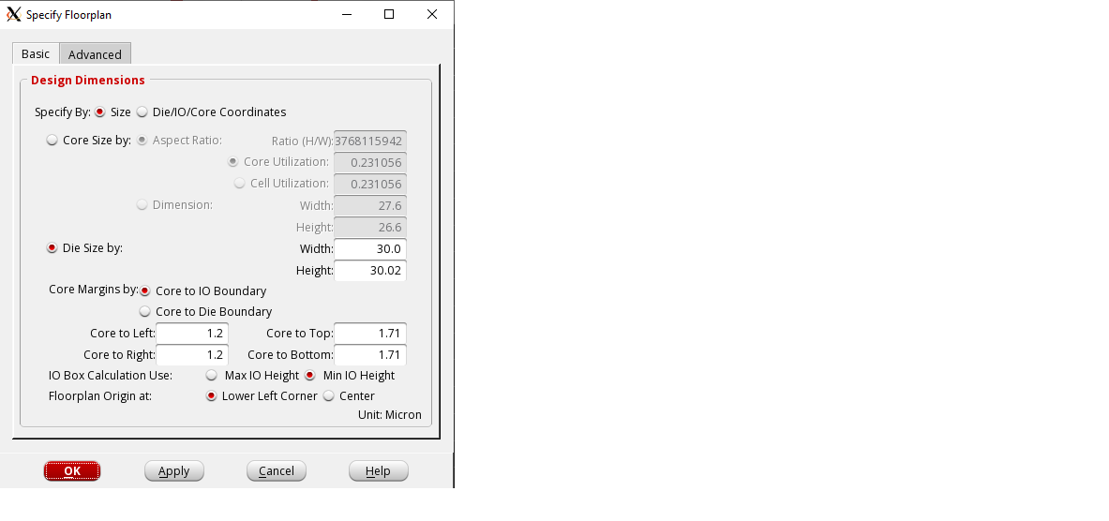
Floorplanning :
Presented by: 1906193

Slide 30
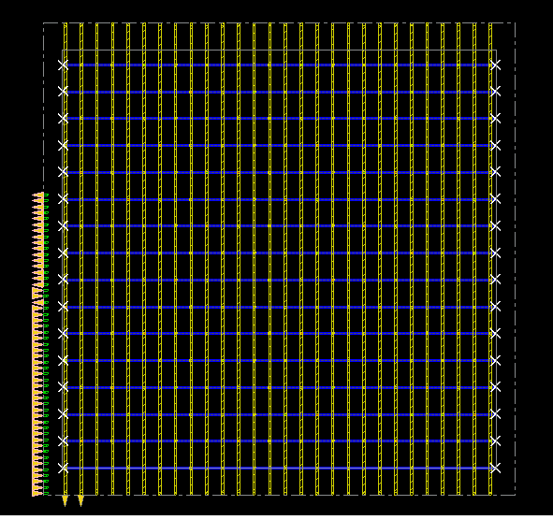
Creating Power Mesh
Presented by: 1906193

Slide 31
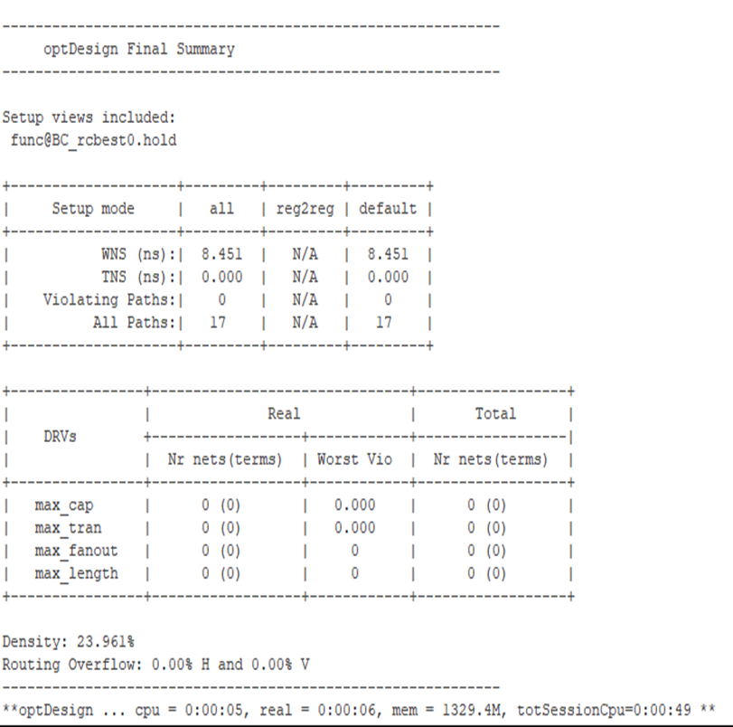
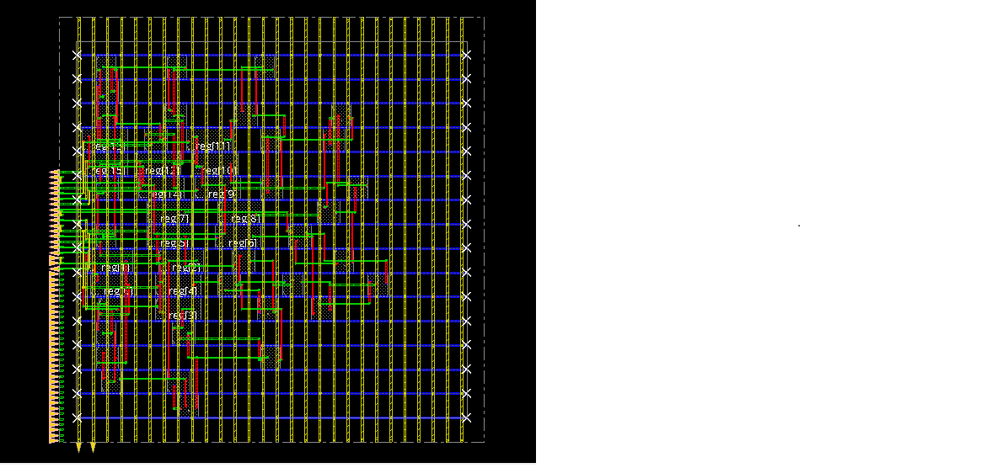
Placement
Presented by: 1906193

Slide 32
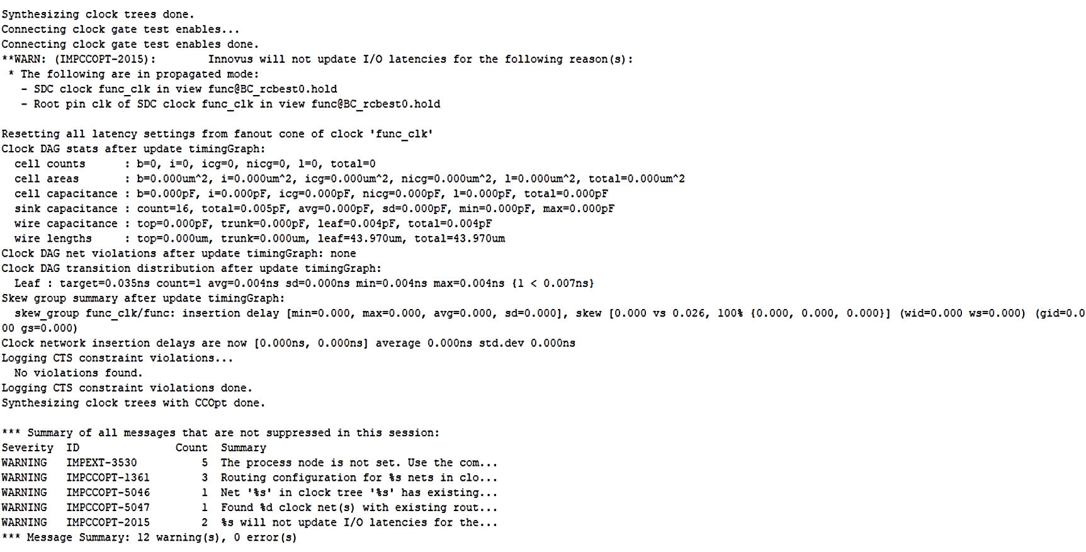
Clock Tree Synthesis (CTS)
Presented by: 1906193

Slide 33
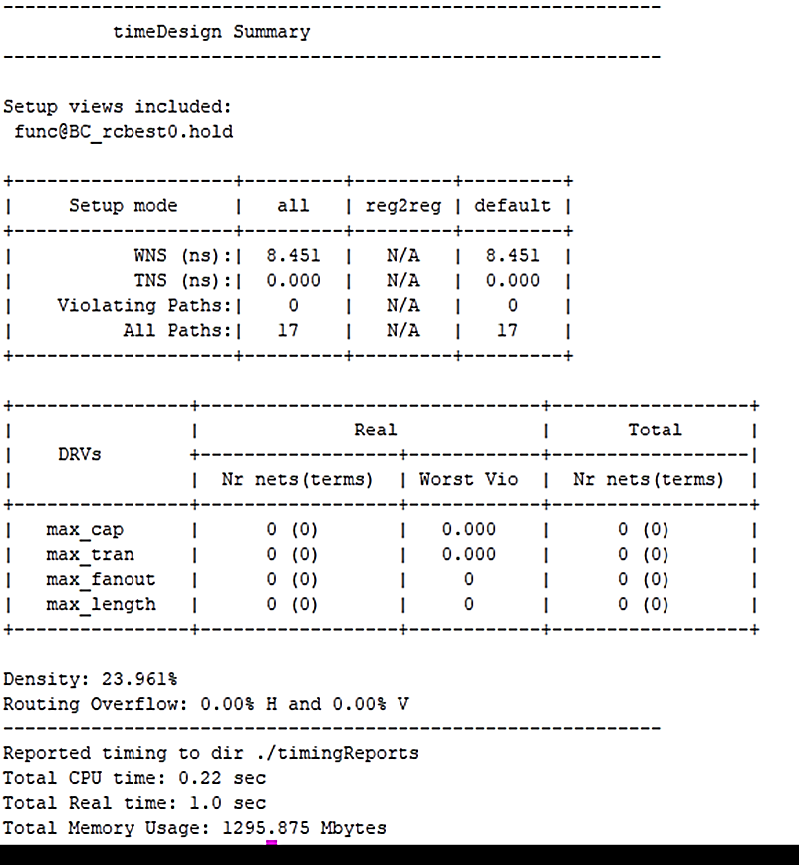
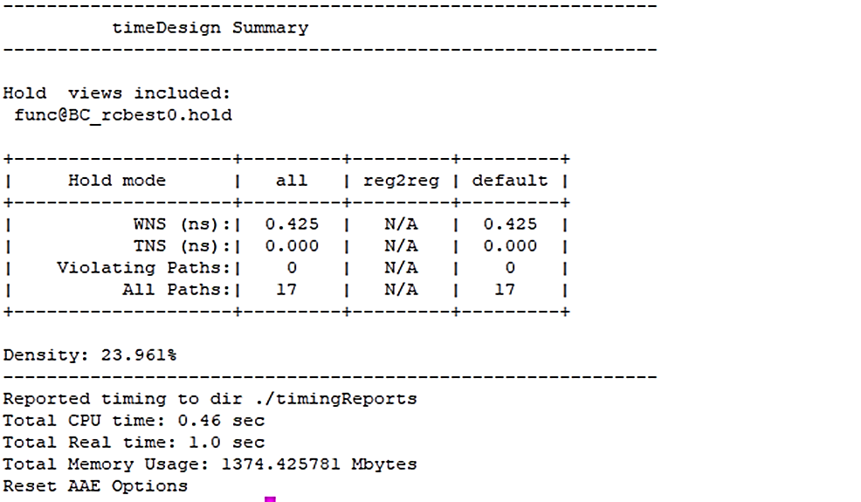
Timedesign Post CTS
Presented by: 1906193

Slide 34
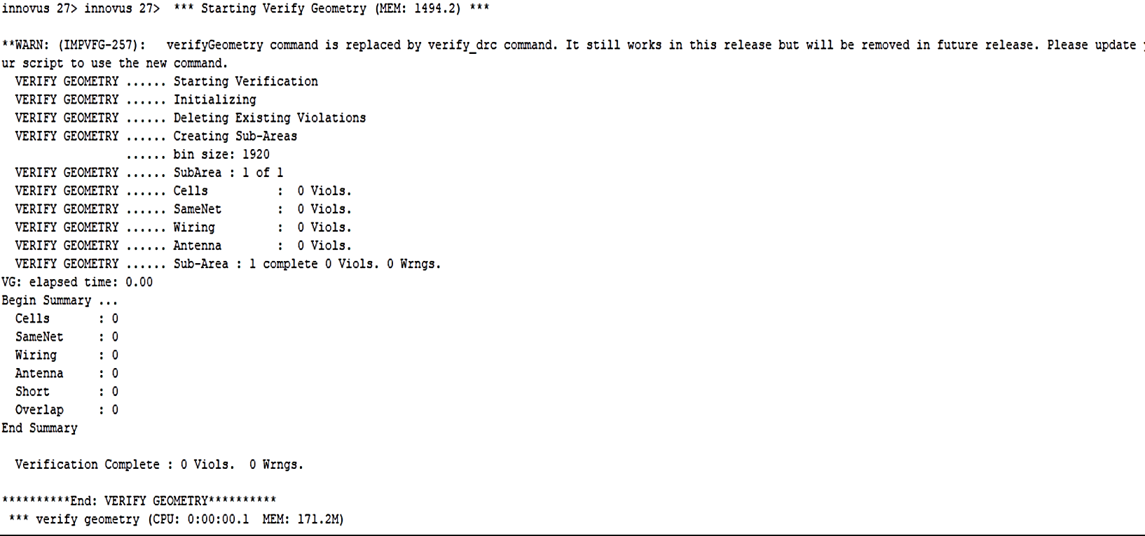
Post-Route timing and SI Optimization
Presented by: 1906193

Slide 35
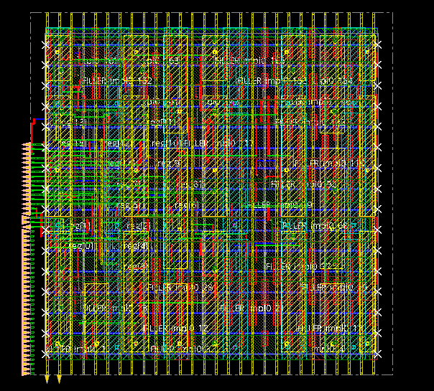
Adding filler cell and metal filling
Presented by: 1906193

Slide 36
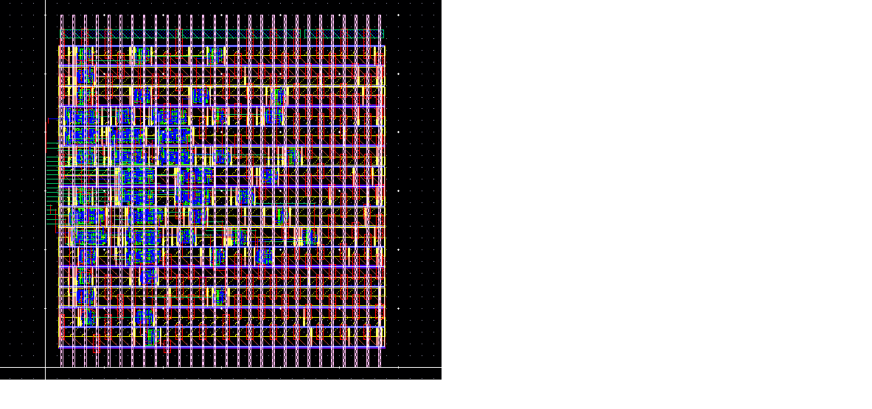
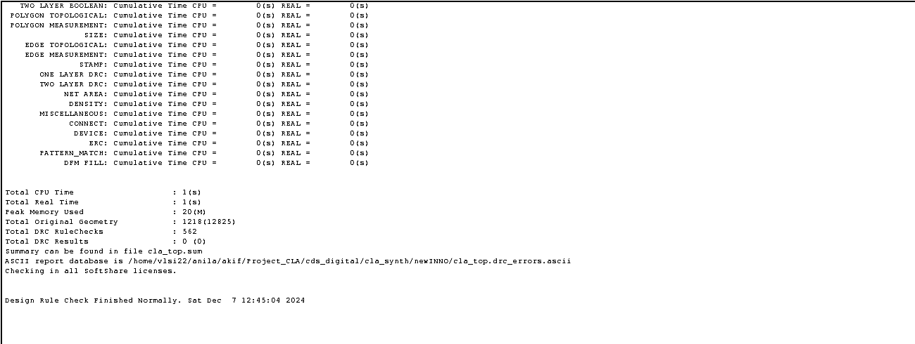
DRC Check:
Presented by: 1906193

Slide 37
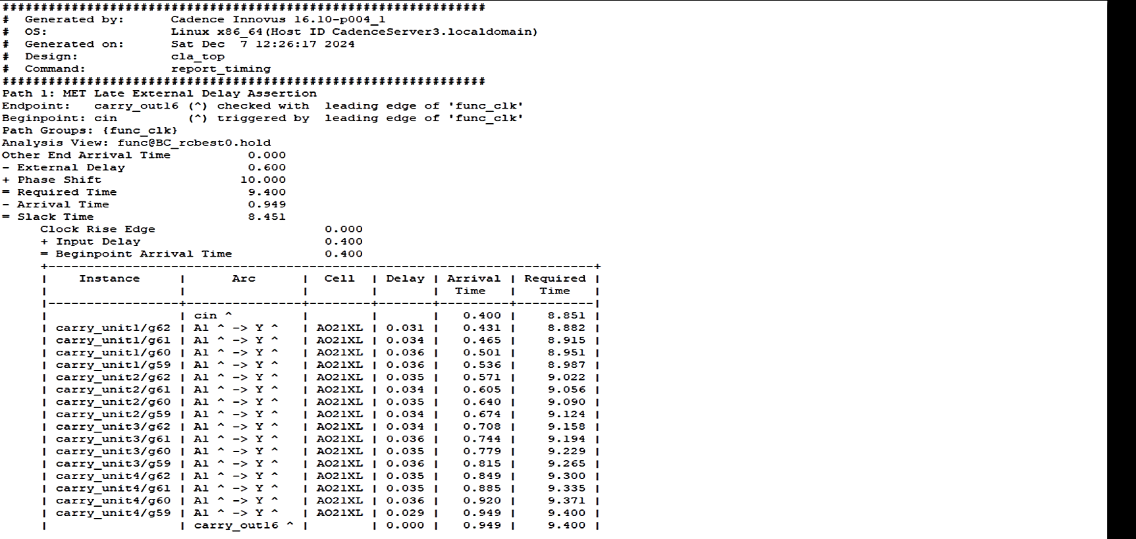
Report Timing
Presented by: 1906193

Slide 38
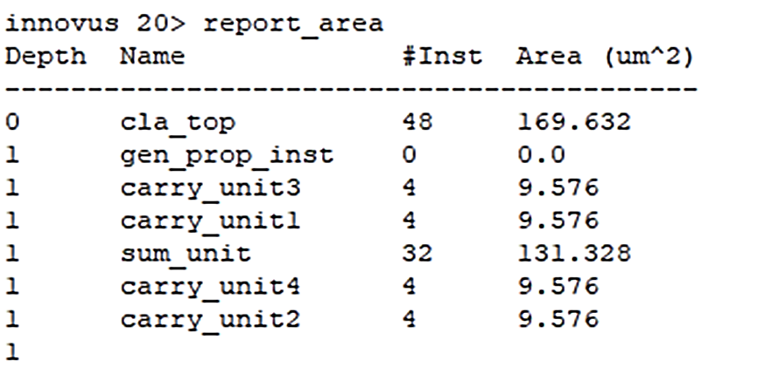
Report Area
Presented by: 1906193

Slide 39
Outline
Summary
PnR with DRC
Introduction
Directed Testbench
Layered Testbench
Design RTL
Synthesis
Optimization Summary
Acknowledgement and References
Presented by: 1906081

Slide 40
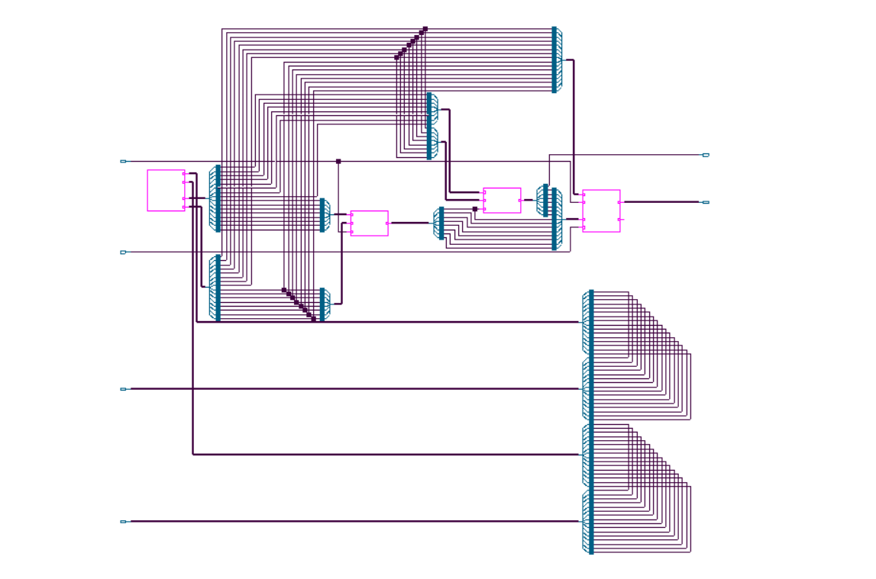
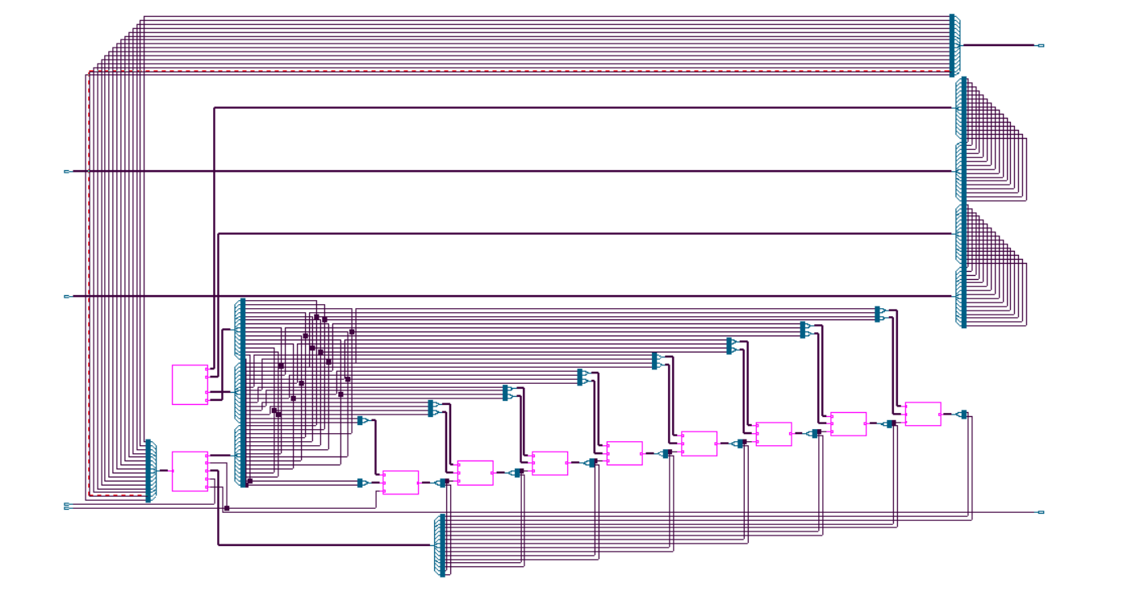
Design Consideration:
2 Carry Unit Blocks
4 Carry Unit Blocks
8 Carry Unit Blocks
Presented by: 1906192

Slide 41
Design Consideration:
2 Carry Unit Blocks
4 Carry Unit Blocks
8 Carry Unit Blocks
Power
5213 nW
5213 nW
1960 nW
Area
255
255
78
Slack Time
7004 ps
7004 ps
UNCONSTRAINED
Presented by: 1906192

Slide 42
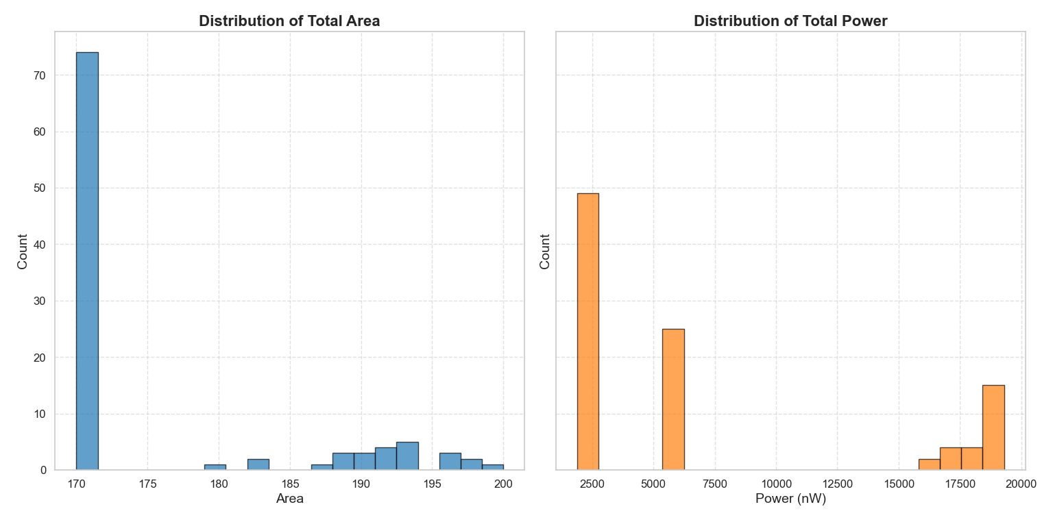
Genus Optimization:
Presented by: 1906192

Slide 43
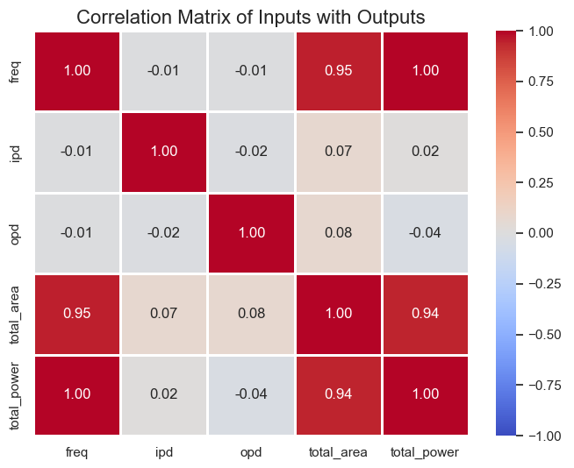
Genus Optimization:
Presented by: 1906192

Slide 44
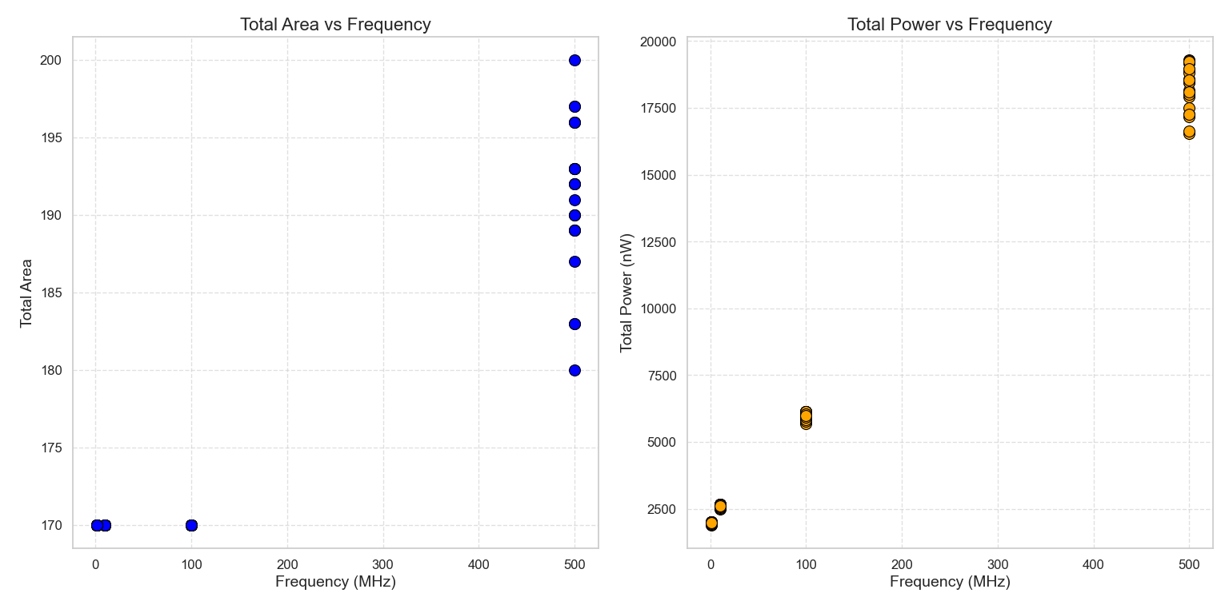
Genus Optimization:
Presented by: 1906192

Slide 45
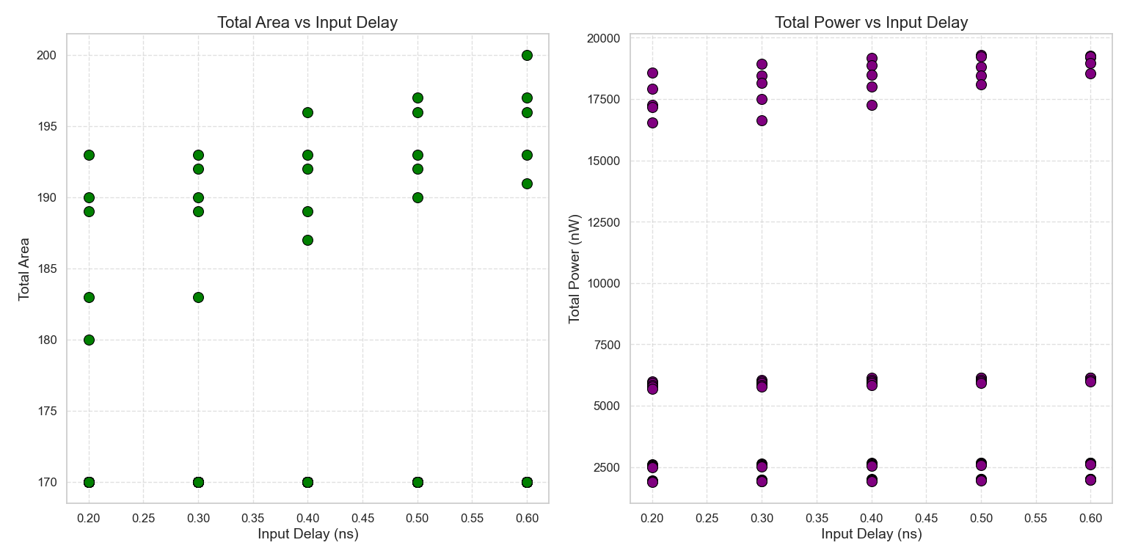
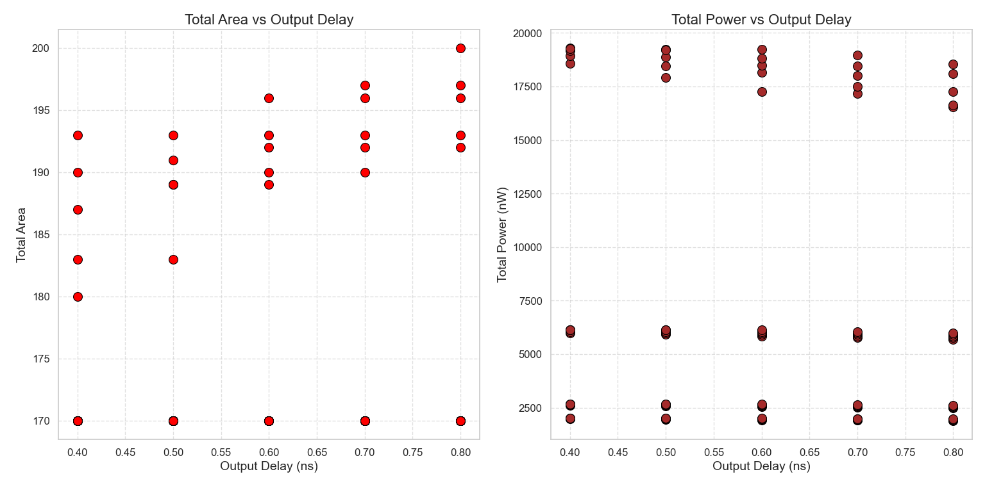
Genus Optimization:
Presented by: 1906192

Slide 46
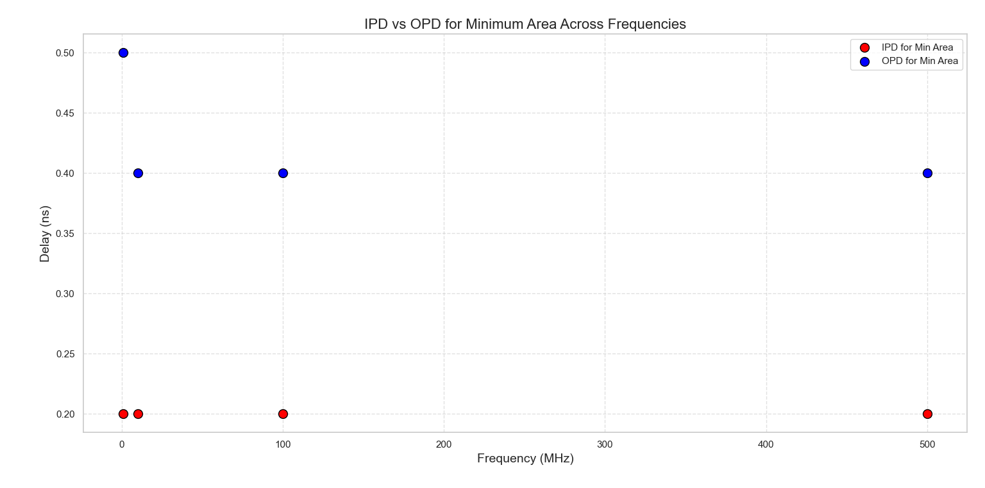
Genus Optimization:
Presented by: 1906192

Slide 47
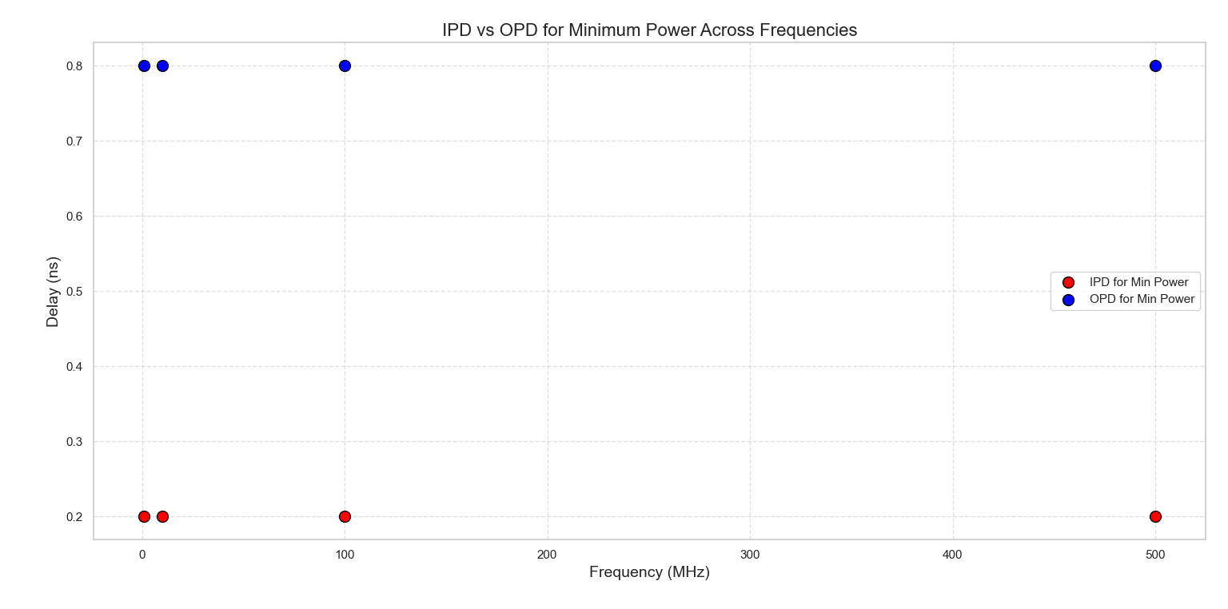
Genus Optimization:
Presented by: 1906192

Slide 48

Genus Optimization:
Presented by: 1906192

Slide 49


Innovus Optimization:
Presented by: 1906192

Slide 50


Innovus Optimization:
Presented by: 1906192

Slide 51


Innovus Optimization:
Presented by: 1906192

Slide 52

Innovus Optimization:
Presented by: 1906192

Slide 53


Innovus Optimization:
Presented by: 1906192

Slide 54
Outline
Summary
PnR with DRC
Introduction
Directed Testbench
Layered Testbench
Design RTL
Synthesis
Optimization
Acknowledgement and References
Presented by: 1906081

Slide 55
References
Bibliography
[1]
[1] G. B. Rosenberger, “Simultaneous Carry Adder,” Dec. 27, 1960 Accessed: Dec. 06, 2024. [Online]. Available: https://patents.google.com/patent/US2966305
[2] N. H. E. Weste and David Money Harris, CMOS VLSI design : a circuits and systems perspective. Noida: Pearson, 2015.
[3] ErcegovacM. D. and LangT., Digital arithmetic. San Francisco, Ca: Morgan Kaufmann Publishers, 2004.
[4] “SystemVerilog TestBench,” ChipVerify. https://www.chipverify.com/systemverilog/systemverilog-simple-testbench
[5] P. Balasubramanian and D. L. Maskell, “A New Carry Look-Ahead Adder Architecture Optimized for Speed and Energy,” Electronics, vol. 13, no. 18, pp. 3668–3668, Sep. 2024, doi: https://doi.org/10.3390/electronics13183668.
Presented by: 1906081

Slide 56
Thank You
Question and Answer Session
Presented by: 1906081

Slide 57
RTL Design (Appendix)
module summation_unit (
input [15:0] p, // Input vector p
input cin, // Carry-in signal
input [16:1] cout, // Carry-out vector for each bit (except for the first bit)
input clk, // Clock signal
output reg [15:0] sum, // Output sum vector
output carry_out16
);
integer i;
always @(posedge clk) begin //changed to posedge for driver and monitor
sum[0] <= p[0] ^ cin; // First bit sum using carry-in
for (i = 1; i < 16; i = i + 1) begin
sum[i] <= p[i] ^ cout[i]; // Remaining bits sum using cout[i]
end
end
assign carry_out16 = cout[16];
endmodule
module gen_prop_unit(
input clk,
input [15:0] a, b,
output [15:0] g, p
);
assign g = a & b; // bitwise generator
assign p = a ^ b; // bitwise propagator
endmodule
module base4_carry_unit(
input [3:0] g, // Generate signals
input [3:0] p, // Propagate signals
input cin, // Carry-in
output [4:1] cout // Carry-out vector
);
assign cout [1] = g[0] | (p[0] & cin);
assign cout [2] = g[1] | (p[1] & cout[1]);
assign cout [3] = g[2] | (p[2] & cout[2]);
assign cout [4] = g[3] | (p[3] & cout[3]);
endmodule
Presented by: 1906081
Notes:
For a direct 16-bit CLA implementation: From equation 2.41, we can see the carry equation becomes very complex as the number of bits increases. For bit position 15, we would need:
One 16-input OR gate
15 AND gates with input sizes ranging from 2 to 16 This makes the implementation impractical due to large fan-in requirements.
ta,g = Time to compute generate and propagate signals
tclg = Time for carry lookahead generator (much smaller for 4-bit groups)
ts = Time to compute final sum
The advantages of this approach:
Each CLA block only needs to handle 4 bits, so:
Maximum OR gate input = 5 (vs 16)
Maximum AND gate input = 5 (vs 16)
Reduced complexity and fan-in
Faster tclg due to simpler logic

Slide 58
RTL Design (Appendix)
// Instantiate the generate and propagate unit for 16 bits
gen_prop_unit gen_prop_inst (
.a(a),
.b(b),
.g(g),
.p(p)
);
// Instantiate the base4 carry unit for the lower 4 bits (a[3:0], b[3:0])
base4_carry_unit carry_unit1 (
.g(g[3:0]),
.p(p[3:0]),
.cin(cin), // The initial carry-in
.cout(cout1) // Carry out for lower 4 bits
);
// Carry-out from the first unit (cout1[4]) becomes the carry-in for the second unit
assign cout_mid1 = cout1[4];
// Instantiate the summation unit to calculate the final 16-bit sum
summation_unit sum_unit (
.p(p), // Propagate signal from the gen_prop_unit
.cin(cin), // Carry-in
.cout({cout4[4:1], cout3[4:1], cout2[4:1], cout1[4:1]}), // Carry-out bits from all carry units
.clk(clk),
.sum(sum), // Output sum
.carry_out16(carry_out16)
);
Presented by: 1906081
Notes:
For a direct 16-bit CLA implementation: From equation 2.41, we can see the carry equation becomes very complex as the number of bits increases. For bit position 15, we would need:
One 16-input OR gate
15 AND gates with input sizes ranging from 2 to 16 This makes the implementation impractical due to large fan-in requirements.
ta,g = Time to compute generate and propagate signals
tclg = Time for carry lookahead generator (much smaller for 4-bit groups)
ts = Time to compute final sum
The advantages of this approach:
Each CLA block only needs to handle 4 bits, so:
Maximum OR gate input = 5 (vs 16)
Maximum AND gate input = 5 (vs 16)
Reduced complexity and fan-in
Faster tclg due to simpler logic

